Slide 1
PRESIDENCY UNIVERSITY
School of PSAIAC | Department of AI & Robotics
Arithmetic Operations on Signed Numbers
Addition and Subtraction of Signed Numbers
CSS2257 • Computer Organization and Architecture
Faculty: D. Venkatesan
Semester I | First-Year Lecture
Presidency University | School of PSAIAC | Dept. of AI & Robotics | CSS2257 – Computer Organization & Architecture

Slide 2
WELCOME
About Today's Class
University
Presidency University
School
PSAIAC
Department
AI & Robotics
Subject
Computer Organization and Architecture
Subject Code
CSS2257
Faculty
D. Venkatesan
Presidency University | School of PSAIAC | Dept. of AI & Robotics | CSS2257 – Computer Organization & Architecture

Slide 3
GETTING ORIENTED
Learning Objectives
Represent positive and negative integers in sign-magnitude, 1's complement, and 2's complement forms.
Explain why 2's complement is the standard representation used in modern computer arithmetic.
Perform binary addition of signed numbers using 2's complement rules.
Perform binary subtraction by converting it into an addition problem.
Detect arithmetic overflow and distinguish it from an ordinary carry.
✓
By the end of this class, you'll be able to add and subtract signed binary numbers the exact way a CPU's ALU does.
Presidency University | School of PSAIAC | Dept. of AI & Robotics | CSS2257 – Computer Organization & Architecture
Notes:
Welcome the class and put these five objectives up as the roadmap for the hour. Tell students that everything today builds toward one skill: doing signed arithmetic exactly the way the processor's Arithmetic Logic Unit does it in hardware. Mention that this is foundational for later topics like ALU design and instruction execution. Encourage them to keep these five objectives in mind and revisit them at the end to self-check their understanding.

Slide 4
WARM-UP
Quick Warm-Up
?
When you hear 'negative number in a computer', what comes to mind?
Have you ever wondered how a calculator subtracts numbers using only 0s and 1s?
True or false: computers have a separate 'subtract' circuit different from 'add'. Guess before we find out!
Which sounds trickier to you: representing -5, or adding -5 to +3? Show of hands.
Presidency University | School of PSAIAC | Dept. of AI & Robotics | CSS2257 – Computer Organization & Architecture
Notes:
Run this as a quick show-of-hands activity — don't let it run past 3-4 minutes. Read each question aloud and take 2-3 quick responses per question rather than a full discussion. For the true/false question, deliberately don't reveal the answer yet — tell them 'hold that thought, we'll answer it by the end of class' to create anticipation. Use their answers to segue: 'Great instincts — today we'll see that computers actually use just ONE circuit for both addition and subtraction, and the trick is how we represent negative numbers.' Keep the tone light and low-stakes; there are no wrong answers here.

Slide 5
MOTIVATION
Why This Topic Matters
Every processor — from a smartwatch to a supercomputer — must add and subtract signed numbers billions of times per second.
Hardware designers want ONE circuit that handles both addition and subtraction to save chip area and power.
Signed number representation affects everything from temperature sensors (negative °C) to bank balances (overdrafts) to game physics (negative velocity).
Get the representation wrong, and you get real bugs: the infamous 'integer overflow' crashes in games, spacecraft, and financial software.
⚡
A single 32-bit adder circuit in your phone's CPU performs both addition and subtraction — because of the trick you'll learn today.
Presidency University | School of PSAIAC | Dept. of AI & Robotics | CSS2257 – Computer Organization & Architecture
Notes:
Open with energy: ask 'why should a first-year student studying AI and Robotics care about binary arithmetic?' Connect it to something relatable — their phone, their laptop, even a robot's motor controller needs to represent negative torque or negative distance. Mention real overflow bugs (e.g., early rocket/software failures caused by arithmetic overflow) as a hook, without going into heavy detail — just enough to show stakes are real. Transition by saying we first need to agree on HOW to write a negative number in binary before we can add or subtract them.

Slide 6
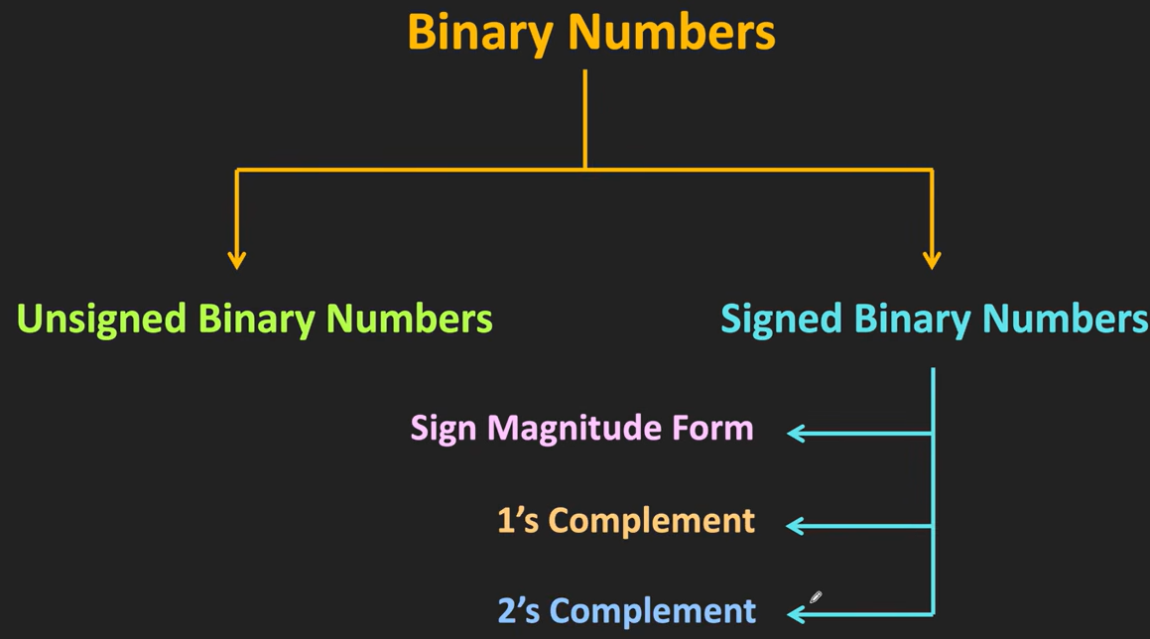

Slide 7
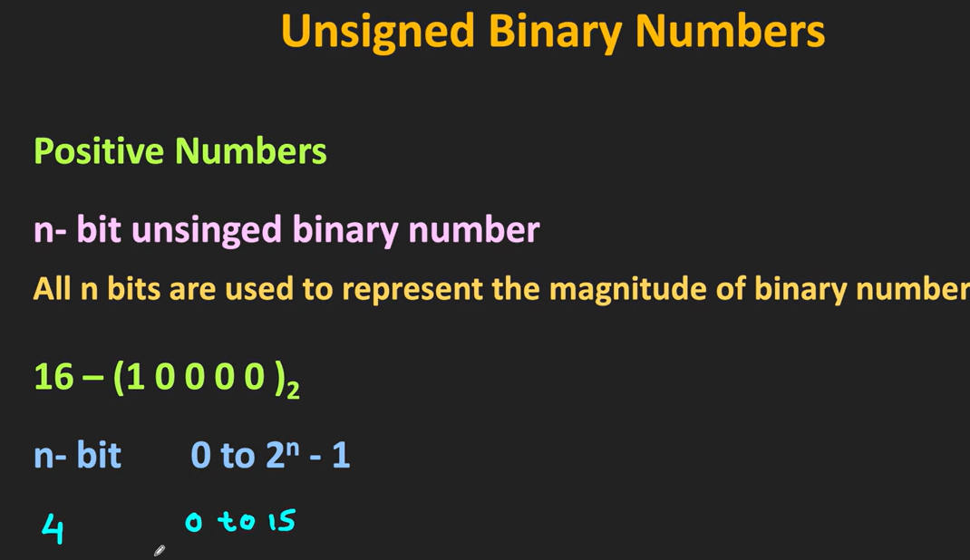

Slide 8
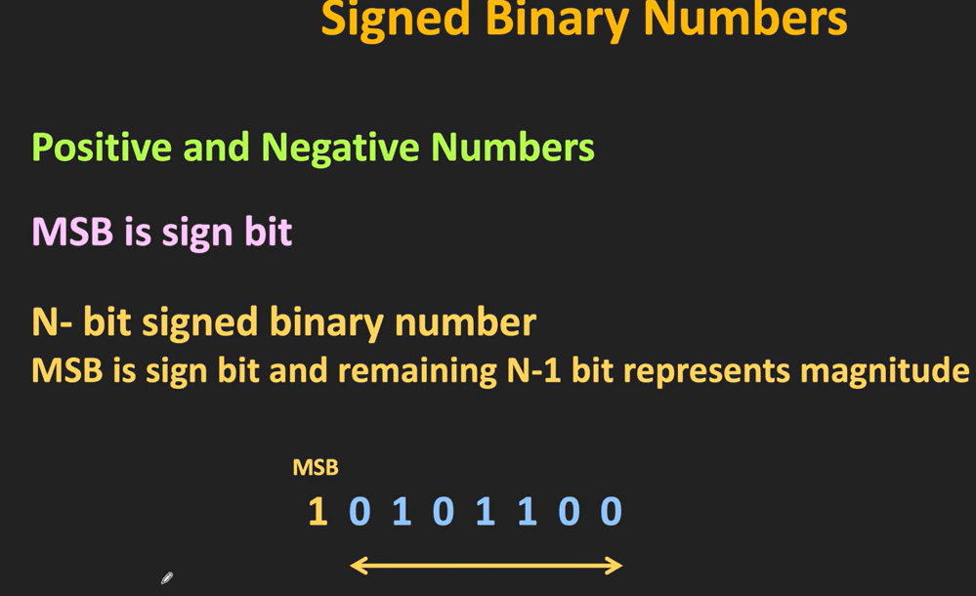

Slide 9
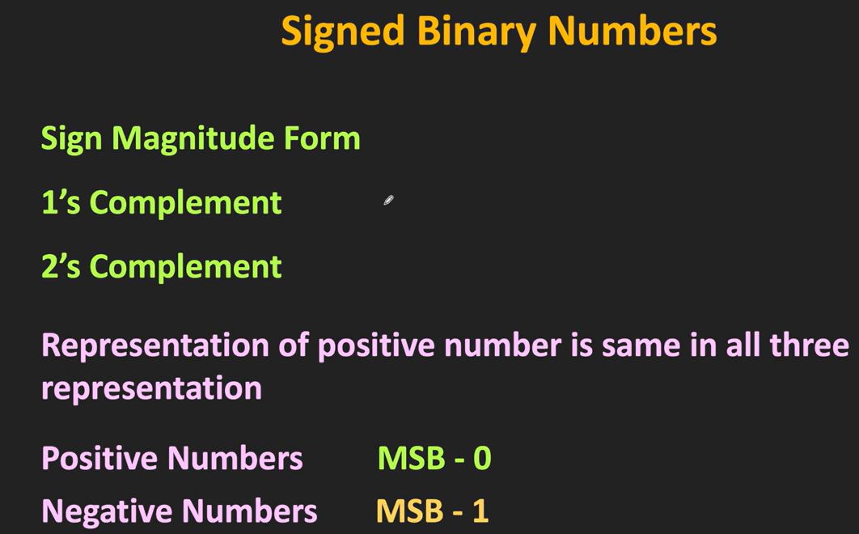

Slide 10
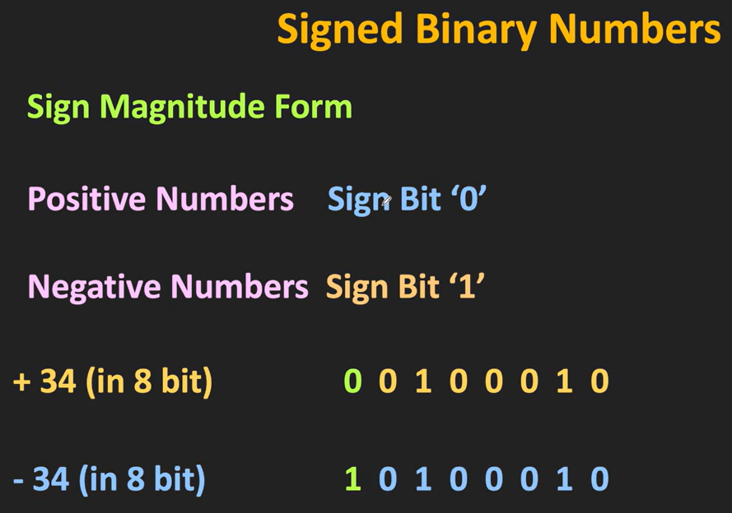

Slide 11
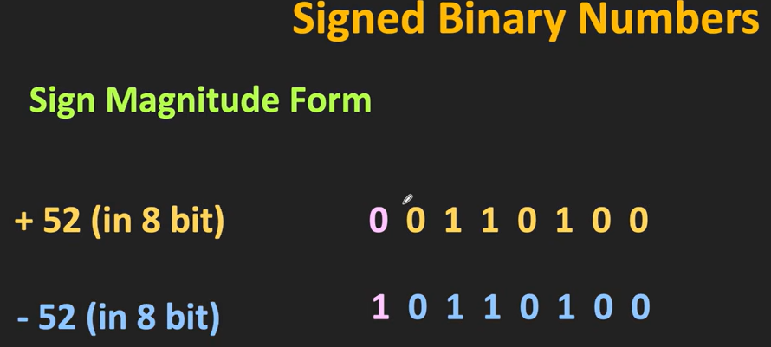

Slide 12
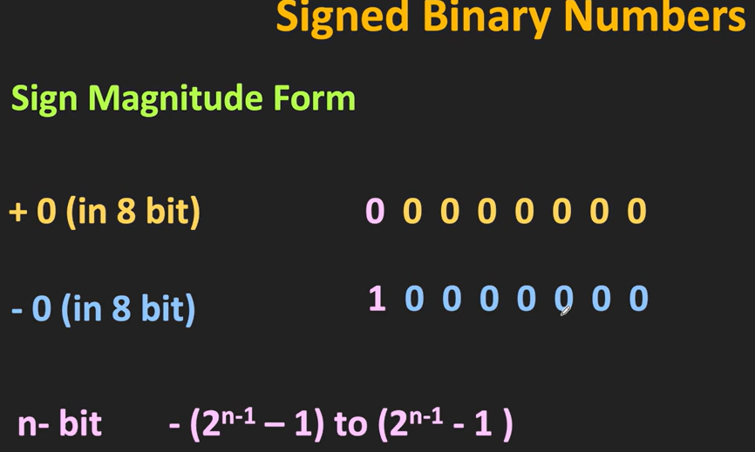

Slide 13
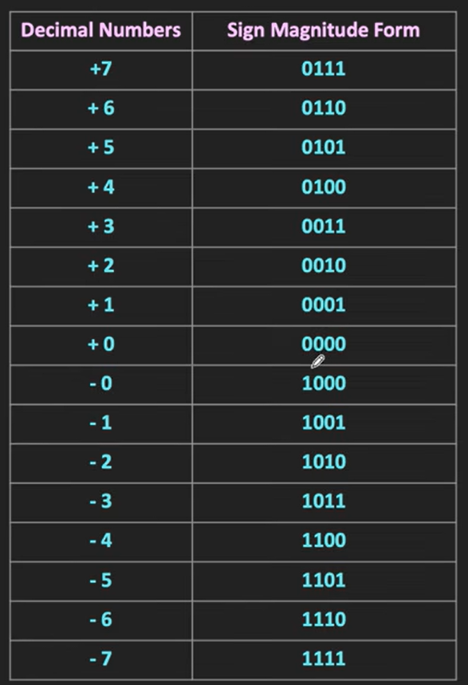
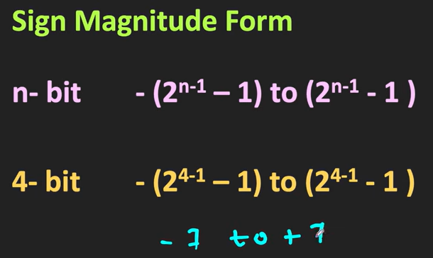

Slide 14
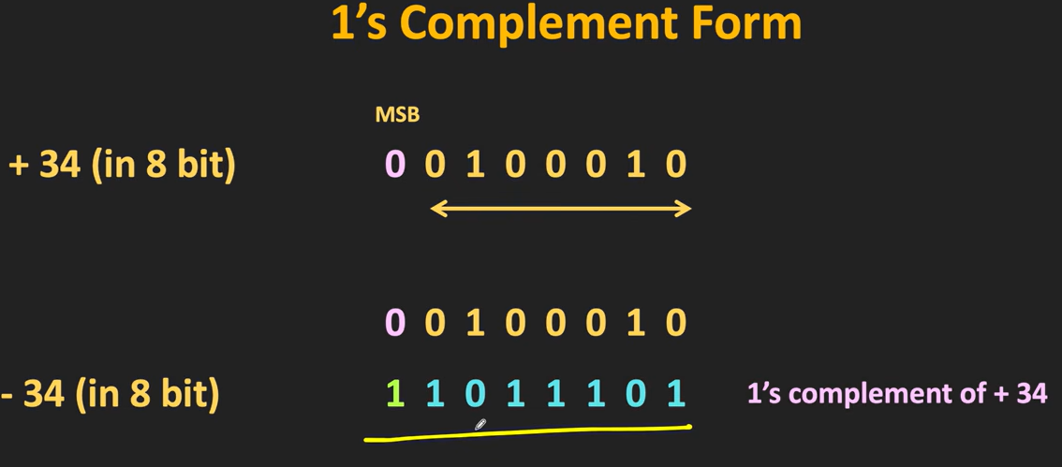

Slide 15
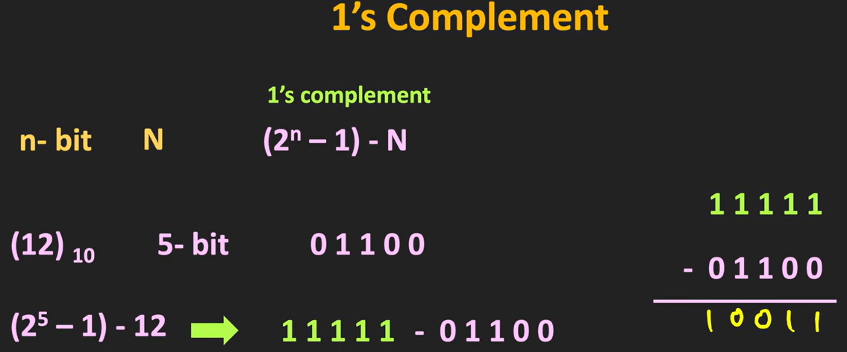

Slide 16
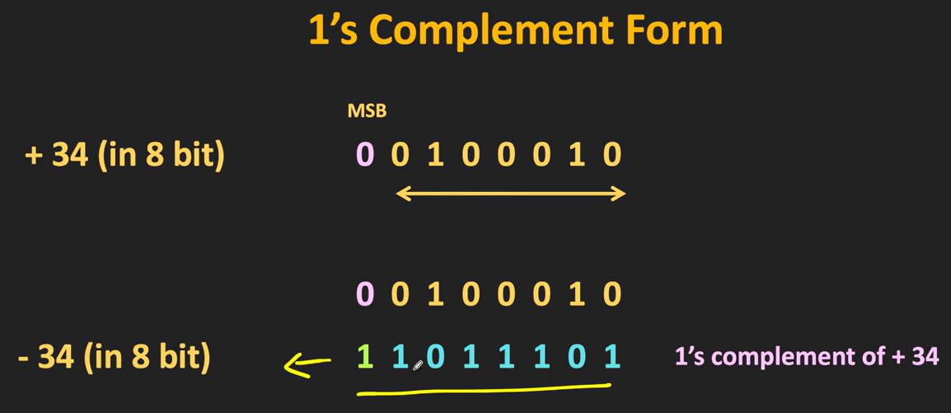

Slide 17
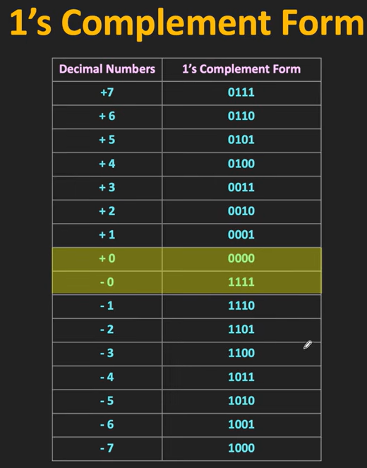

Slide 18
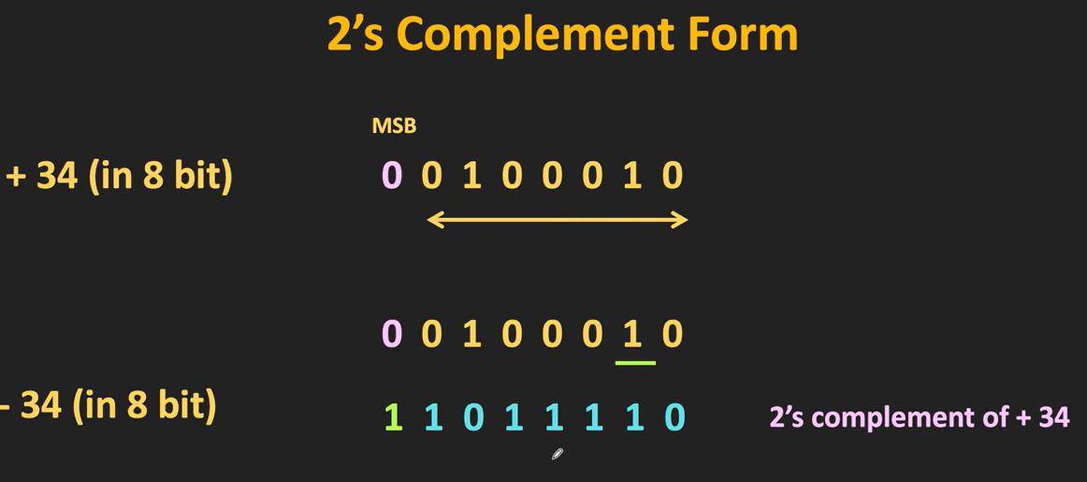

Slide 19
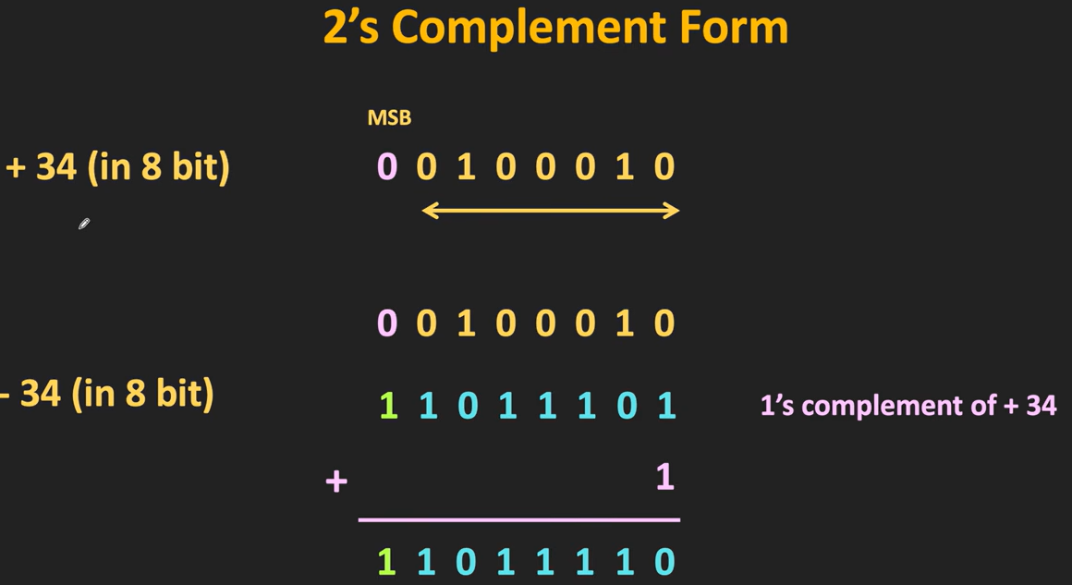

Slide 20
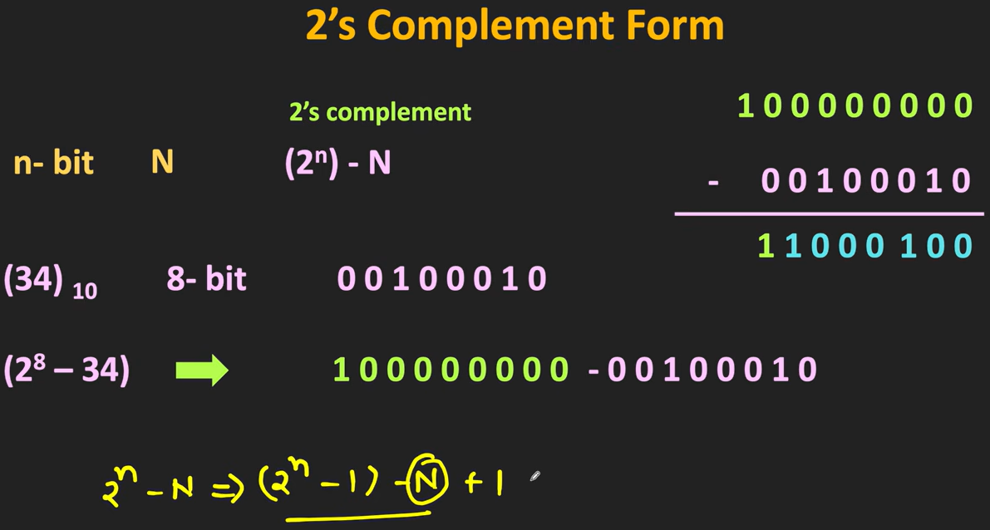

Slide 21
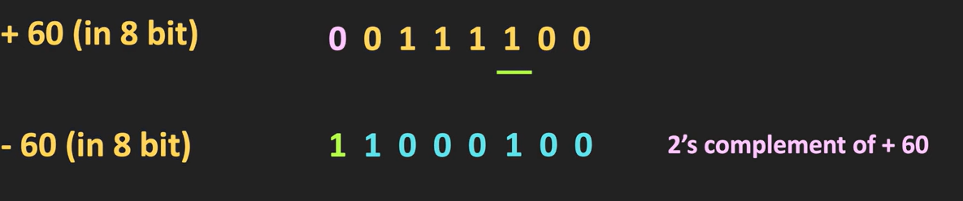

Slide 22
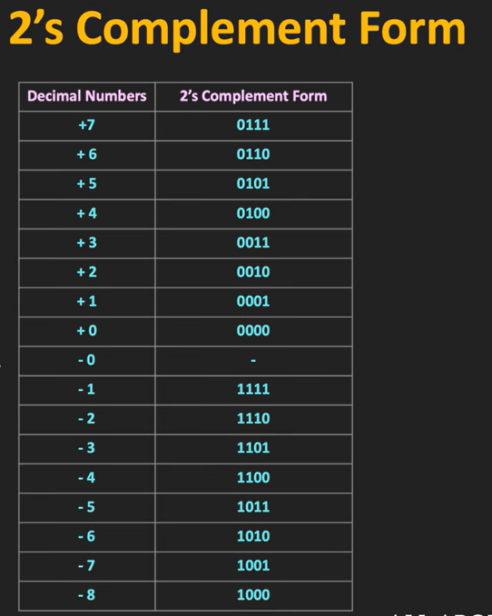

Slide 23
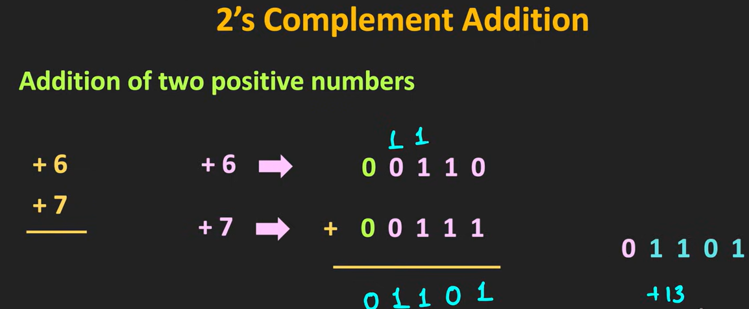

Slide 24
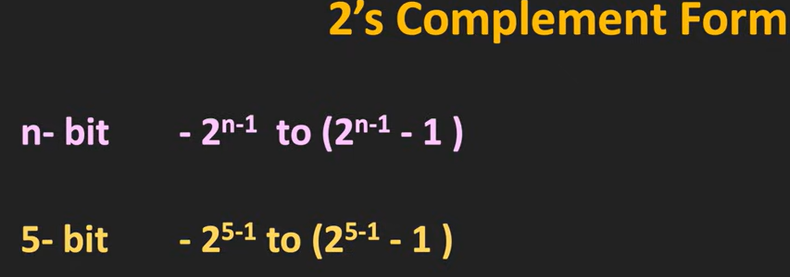

Slide 25
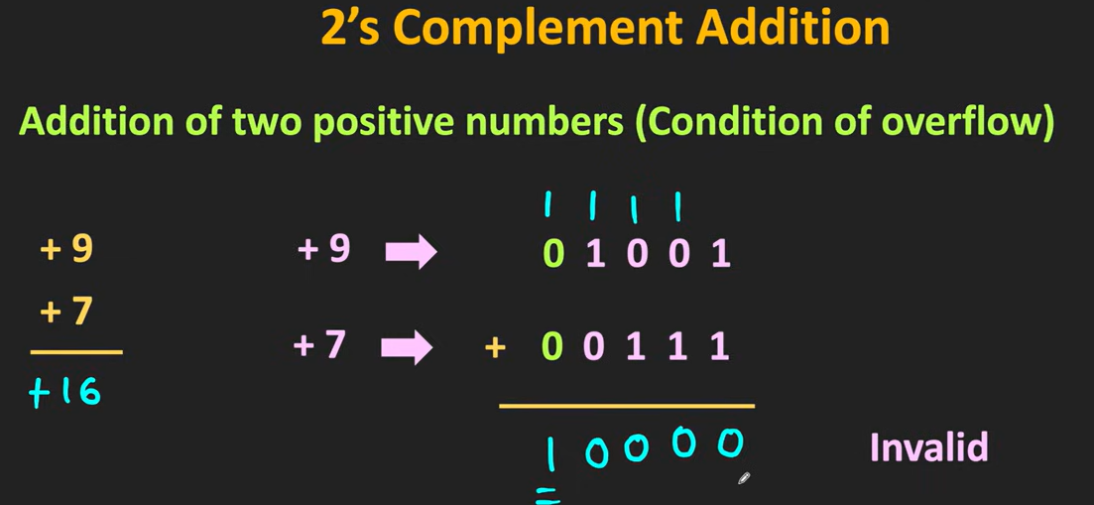

Slide 26
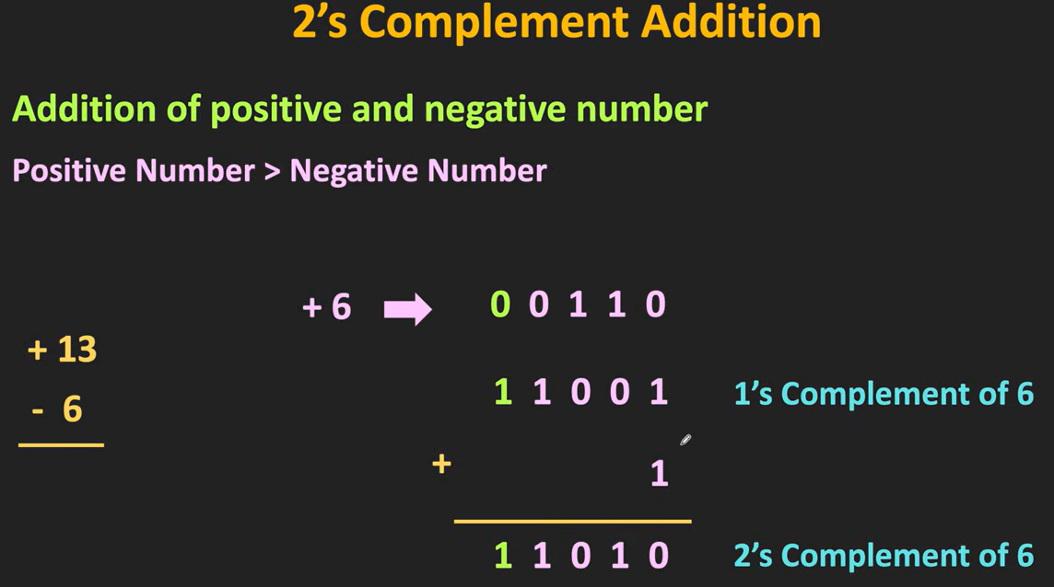

Slide 27
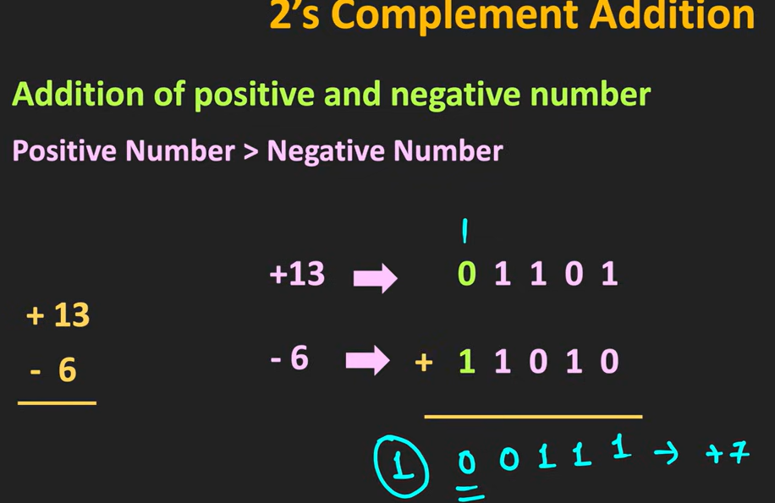

Slide 28
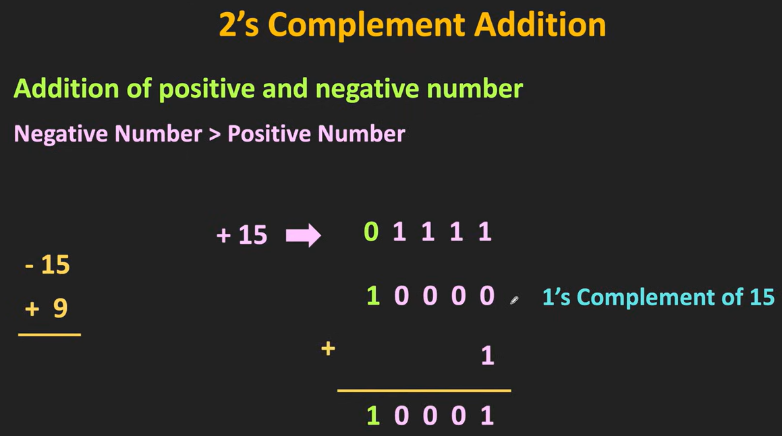

Slide 29
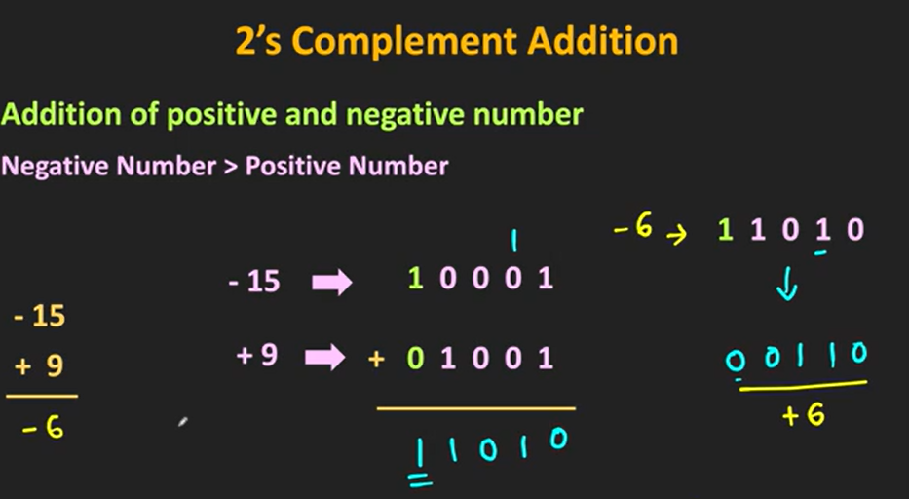

Slide 30
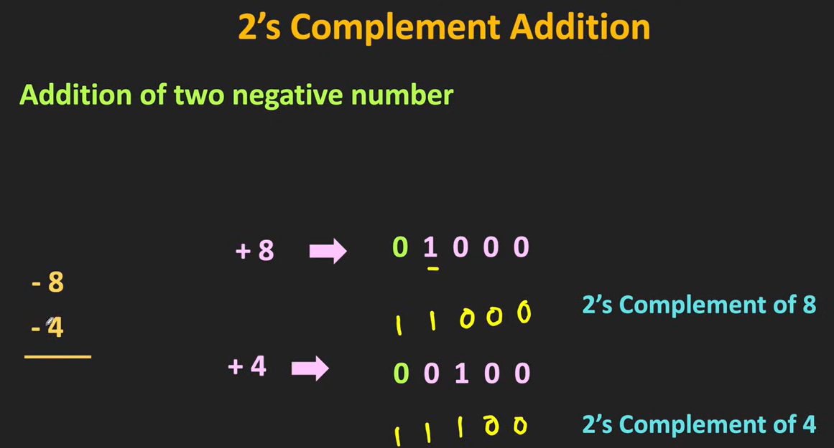

Slide 31
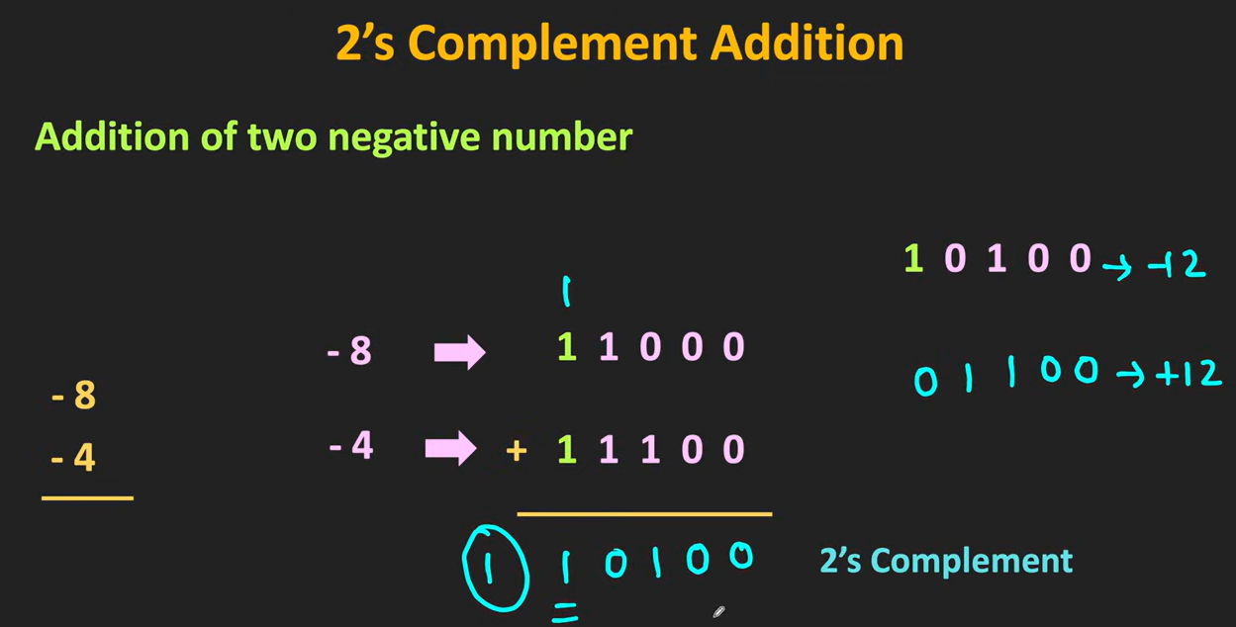

Slide 32
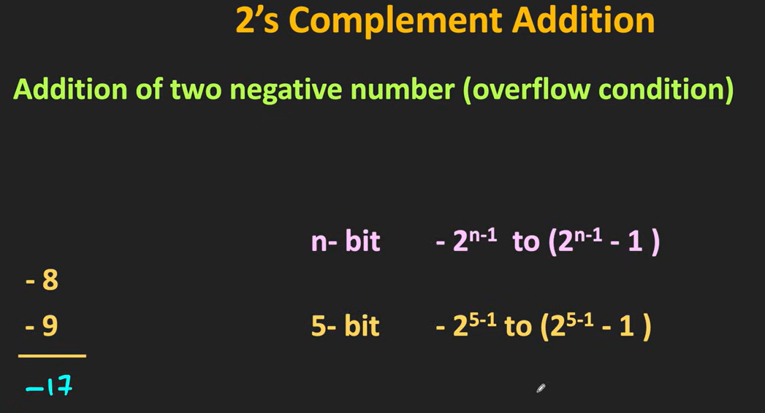

Slide 36
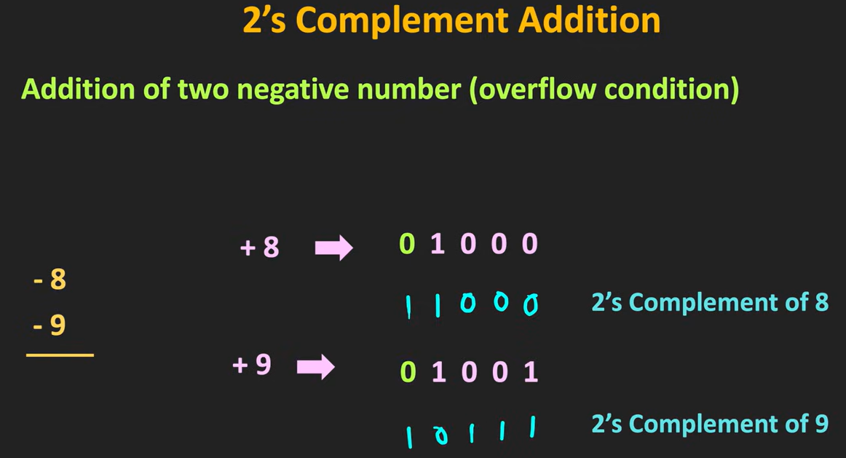

Slide 37
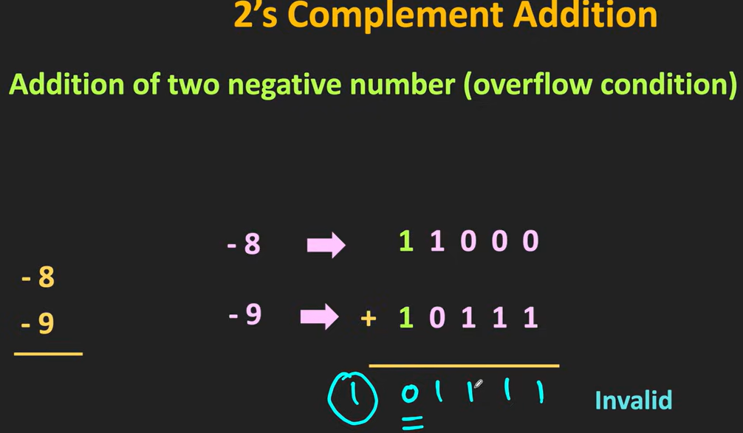

Slide 38
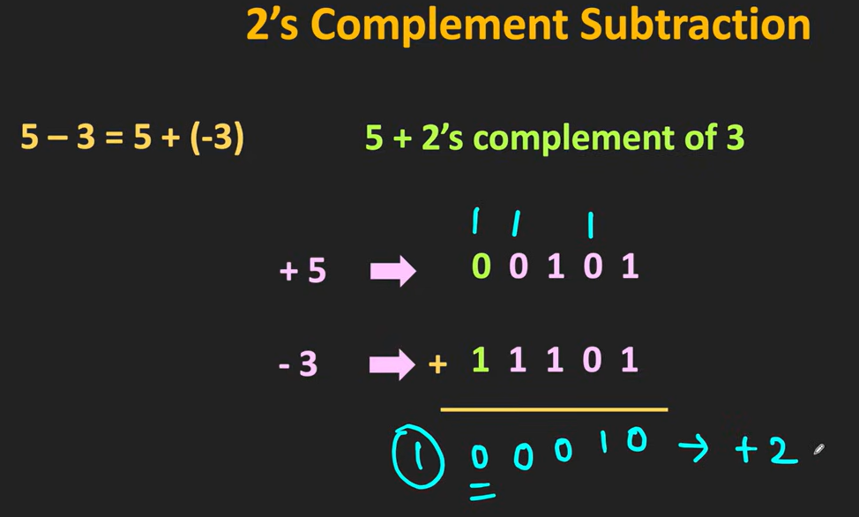
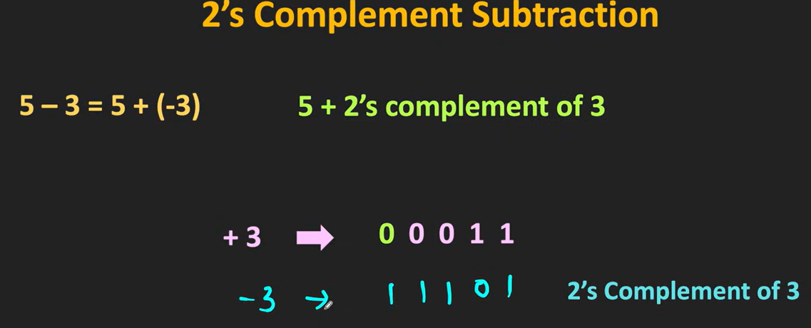

Slide 39
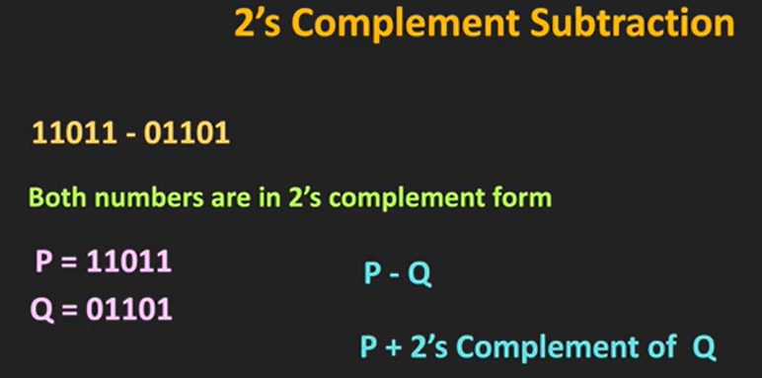
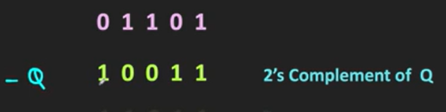

Slide 40
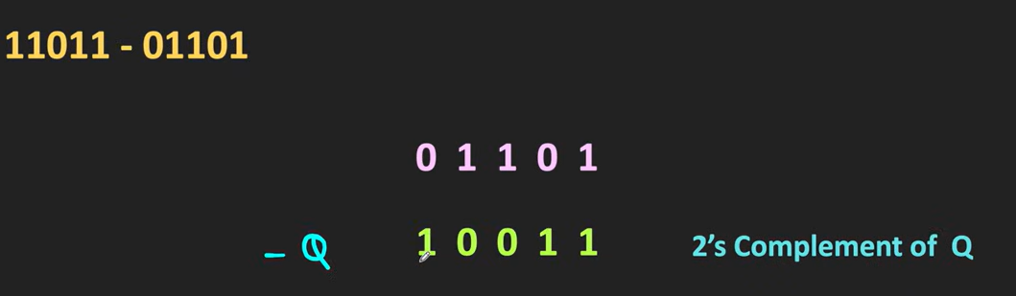
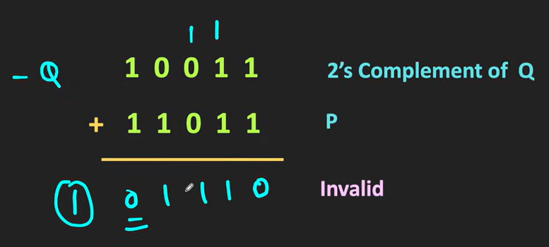

Slide 41
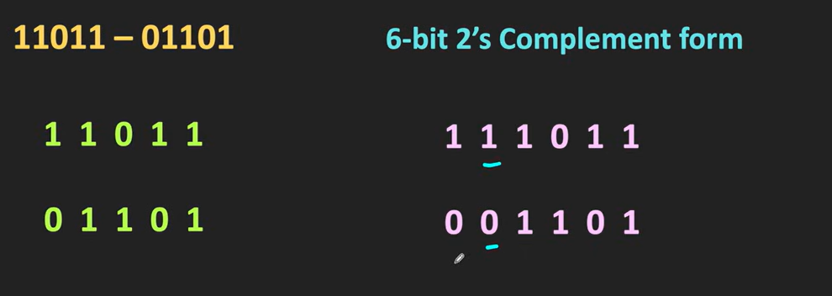
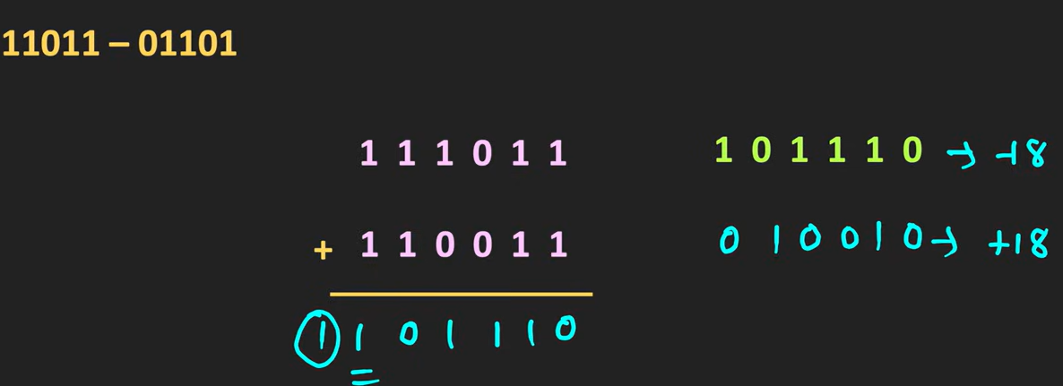

Slide 42
FOUNDATIONS
Quick Recap: Unsigned Binary Numbers
Binary uses only two digits: 0 and 1 — each digit is called a bit.
Each bit position represents a power of 2 (…, 8, 4, 2, 1) reading right to left.
Example: 1011₂ = (1×8)+(0×4)+(1×2)+(1×1) = 11 in decimal.
So far, every number we've written has been positive (unsigned) — there's been no way to show a minus sign!
01
1011₂ → 11₁₀
But how do we write −11?
Presidency University | School of PSAIAC | Dept. of AI & Robotics | CSS2257 – Computer Organization & Architecture
Notes:
This is a fast recap, not new material — most students have seen positional binary before, so move briskly (about 3 minutes). Work the example 1011 = 11 on the board step by step: 8+0+2+1. Ask a rhetorical question: 'if all we have are 0s and 1s, how would you even write a negative sign?' Pause for a moment to let it sink in, then say 'that's exactly the puzzle we're solving today.' This sets up the motivation for signed representations on the next slides.

Slide 43
FOUNDATIONS
Three Ways to Represent Signed Numbers
1. Sign-Magnitude — reserve the leftmost (MSB) bit purely as a sign flag: 0 = positive, 1 = negative.
2. 1's Complement — flip every bit of the positive number to represent its negative.
3. 2's Complement — flip every bit and add 1. This is what real computers use.
We'll walk through all three with the same example, +5 and −5, using 4 bits, so you can compare them directly.
±
Same value (5), three different negative representations. Only one of them survives into modern hardware.
Presidency University | School of PSAIAC | Dept. of AI & Robotics | CSS2257 – Computer Organization & Architecture
Notes:
Introduce this as a menu of three historical approaches — sign-magnitude and 1's complement are stepping stones, 2's complement is the destination. Tell students not to worry about memorizing all three; the goal is to understand WHY 2's complement won out. Use +5 and -5 as the running example across the next several slides so students can directly compare representations. Write '0101' for +5 on the board as the shared starting point.

Slide 44
REPRESENTATION 1 OF 3
Sign-Magnitude Representation
MSB (leftmost bit) = sign: 0 for positive, 1 for negative. Remaining bits = magnitude.
+5 in 4 bits = 0101 → −5 in 4 bits = 1101 (just flip the sign bit).
Simple to read, but arithmetic circuits become complicated — addition rules differ depending on the signs.
Problem: there are TWO representations of zero — 0000 (+0) and 1000 (−0). This wastes a code and confuses comparisons.
±
+5 = 0101
−5 = 1101
Sign bit flips,
magnitude stays same
Presidency University | School of PSAIAC | Dept. of AI & Robotics | CSS2257 – Computer Organization & Architecture
Notes:
Walk through the +5/-5 example on the board — emphasize that only the leftmost bit changes. Ask students: 'what decimal number does 1000 represent here?' Let them work out it's -0, then ask 'is that a problem?' Guide them to see that having two zeros is wasteful and creates ambiguity for a comparison circuit (is 0000 equal to 1000?). This motivates why engineers looked for a better scheme. Keep pace moving — about 3-4 minutes on this slide.

Slide 45
REPRESENTATION 2 OF 3
1's Complement Representation
To negate a number, flip every bit (0→1, 1→0). This is called the 'complement' of the number.
+5 in 4 bits = 0101 → −5 = 1's complement of 0101 = 1010.
Better than sign-magnitude for circuit design, but still has TWO zeros: 0000 (+0) and 1111 (−0).
Addition also needs a correction step called 'end-around carry' — an extra bit must be added back in, which slows hardware down.
↻
0101 → flip all bits
1010
(that's −5)
Presidency University | School of PSAIAC | Dept. of AI & Robotics | CSS2257 – Computer Organization & Architecture
Notes:
Demonstrate the bit-flip mechanically: 0101 becomes 1010. Ask a student to flip a different number live, e.g. +3 = 0011 → -3 = 1100, and check it as a class. Mention briefly that 1's complement addition needs an 'end-around carry' fix-up step — you don't need to work a full example now, just flag it as an extra complication that 2's complement will eliminate. Reiterate the double-zero problem persists here too. This bridges naturally into 2's complement as 'the fix for both problems.'

Slide 46
REPRESENTATION 3 OF 3 — THE WINNER
2's Complement Representation
Rule: to negate a number, flip every bit AND add 1 to the result.
+5 in 4 bits = 0101 → flip → 1010 → add 1 → 1011. So −5 = 1011.
Only ONE representation of zero (0000) — no ambiguity, no wasted code.
Addition and subtraction can both be done with the SAME adder circuit, with no extra correction steps.
2's
0101
→ flip → 1010
→ +1 → 1011
That's −5
Presidency University | School of PSAIAC | Dept. of AI & Robotics | CSS2257 – Computer Organization & Architecture
Notes:
This is the most important slide of the lecture — slow down here. Work the full 3-step process on the board: write 0101, flip every bit to get 1010, then add 1 to get 1011. Ask students to verify: 1011 should be -5, so if we add 0101 (+5) and 1011 (-5) the result should be zero — do this addition together and show it comes out to 10000, which in 4 bits truncates to 0000. That 'proof by addition' is very convincing and worth the extra two minutes. Emphasize: this is exactly what every modern CPU does.

Slide 47
FOUNDATIONS
Range of an n-bit 2's Complement Number
Bits (n) | Range | Example (n = 4)
4 bits | −8 to +7 | 1000 = −8, 0111 = +7
8 bits | −128 to +127 | used for a 'byte'
16 bits | −32,768 to +32,767 | used for 'short int'
32 bits | −2,147,483,648 to +2,147,483,647 | used for 'int' in C/Java
General formula for n bits: range is −2ⁿ⁻¹ to +2ⁿ⁻¹ − 1. Notice the range is NOT symmetric — there's one extra negative number!
Presidency University | School of PSAIAC | Dept. of AI & Robotics | CSS2257 – Computer Organization & Architecture
Notes:
Point out the general formula −2^(n-1) to +2^(n-1)-1 and derive the 4-bit case together: n=4 gives -8 to +7, which is 16 total values (2^4), matching 16 bit patterns. Ask students why the range isn't symmetric — there's one more negative number than positive. The answer: 0000 is 'used up' by zero on the positive side, but there's no matching '−0', so the extra pattern (1000) goes to represent the most negative number instead. This is a classic exam question, so flag it clearly.

Slide 48
FOUNDATIONS
Why 2's Complement Is the Industry Standard
Exactly one representation of zero — simplifies comparison and 'is-it-zero' circuits.
Subtraction becomes addition: A − B is computed as A + (−B), so no separate subtractor circuit is needed.
No end-around carry correction — the same adder hardware works for signed and unsigned numbers.
This is why every CPU, GPU, and microcontroller you'll ever program uses 2's complement internally.
⚙
One adder circuit.
Two jobs: add AND subtract.
That's the power of 2's complement.
Presidency University | School of PSAIAC | Dept. of AI & Robotics | CSS2257 – Computer Organization & Architecture
Notes:
Summarize the previous three slides into 'why this one wins.' This is a good moment for a rhetorical question: 'if you were a chip designer trying to save space and power, which of the three schemes would you pick, and why?' Let a couple of students answer before confirming 2's complement. Reinforce that everything from here onward in the course — and in any programming language they'll use — relies on this representation under the hood.

Slide 49
CORE CONCEPT
Rule for Adding 2's Complement Numbers
Simply add the two binary numbers bit by bit, exactly like unsigned addition — no special cases needed!
If a carry is generated out of the leftmost (sign) bit, DISCARD it — it does not affect the result.
The sign bit of the result is automatically correct if there is no overflow (next slides explain overflow).
This single rule works whether both numbers are positive, both negative, or one of each.
+
Add like normal binary.
Drop any final carry-out.
Done!
Presidency University | School of PSAIAC | Dept. of AI & Robotics | CSS2257 – Computer Organization & Architecture
Notes:
Emphasize how refreshingly simple this rule is compared to sign-magnitude: 'just add them like any binary numbers, and throw away a carry that falls off the left edge.' Don't work a full numeric example yet — that's coming in the worked-examples section — but you can do a tiny mental example: 0001 + 0001 = 0010 (1+1=2), no carry issue. Preview that the only thing we need to watch out for is overflow, which is coming up next.

Slide 50
CORE CONCEPT
Rule for Subtracting 2's Complement Numbers
Golden rule: A − B = A + (−B). We never subtract directly — we negate B and add.
Step 1: Find the 2's complement of B (flip all bits, add 1).
Step 2: Add the result to A using the normal addition rule from the previous slide.
Step 3: Discard any carry out of the sign bit, just like in addition.
−
Subtraction is
secretly just
ADDITION of a
negated number.
Presidency University | School of PSAIAC | Dept. of AI & Robotics | CSS2257 – Computer Organization & Architecture
Notes:
This is the key insight that answers the icebreaker question from earlier: computers don't need a separate subtract circuit! Walk through the three steps as a checklist students can use in any problem. Point out this is exactly why we spent so much time learning to negate numbers with 2's complement — that skill directly enables subtraction. Tell them we'll do several full numeric examples in the next few slides.

Slide 51
CORE CONCEPT
What Is Arithmetic Overflow?
Overflow happens when the TRUE mathematical result doesn't fit in the number of bits available.
Example (4-bit): +5 + +5 = +10, but the max positive value in 4 bits is only +7 — overflow!
Overflow is a DIFFERENT concept from carry-out — carry-out is about bits, overflow is about whether the sign makes sense.
Detecting overflow matters because an overflowed result is simply WRONG, and hardware must flag it.
⚠
0101 (+5)
+0101 (+5)
= 1010
Looks like −6!
That's overflow.
Presidency University | School of PSAIAC | Dept. of AI & Robotics | CSS2257 – Computer Organization & Architecture
Notes:
This is a conceptually tricky idea, so slow down. Work the +5 + +5 example on the board: 0101 + 0101 = 1010. Ask students to interpret 1010 as a signed 4-bit number — they should recognize it as −6, which is clearly wrong since 5+5=10, not -6. Explain that this mismatch (adding two positives and getting a negative) is the signature of overflow. Reassure them there's a simple mechanical rule to detect it, coming next.

Slide 52
CORE CONCEPT
How to Detect Overflow — The Simple Rule
Rule of thumb: overflow occurs only when adding two numbers of the SAME sign produces a result with the OPPOSITE sign.
Positive + Positive = Negative result → overflow.
Negative + Negative = Positive result → overflow.
Positive + Negative can NEVER overflow — the true result always fits in fewer bits than either operand.
⚠
Same sign in,
opposite sign out
= OVERFLOW
Presidency University | School of PSAIAC | Dept. of AI & Robotics | CSS2257 – Computer Organization & Architecture
Notes:
Give students this as a memorable, exam-ready rule: same-sign-in, opposite-sign-out means overflow. Reinforce with the previous slide's example: two positives (+5, +5) produced a negative (−6) — overflow confirmed. Ask the class: 'can adding a positive and a negative number ever overflow?' Guide them to reason that a positive plus a negative is always closer to zero than either number alone, so it can never exceed the range. This is a great 'check your understanding' moment — consider a 30-second pair discussion here.

Slide 53
CORE CONCEPT
Hardware View: The Carry-In / Carry-Out Rule
Hardware designers use an even faster check: compare the carry INTO the sign bit with the carry OUT of the sign bit.
If these two carries are DIFFERENT, overflow has occurred.
If these two carries are the SAME (both 0 or both 1), there is no overflow.
This rule needs no sign interpretation at all — it's just one XOR gate in real hardware!
XOR
Carry-in ≠ Carry-out
→ Overflow flag = 1
(one XOR gate)
Presidency University | School of PSAIAC | Dept. of AI & Robotics | CSS2257 – Computer Organization & Architecture
Notes:
This is the 'engineer's version' of the previous slide's rule, and it's worth mentioning because it's literally how the overflow flag is built in a real ALU: a single XOR gate comparing the two carry bits. You don't need to derive carry propagation bit by bit here — just state the rule and note that both this and the sign-based rule from the last slide always agree; they're two views of the same phenomenon. This nicely foreshadows a later lecture on ALU/adder circuit design.

Slide 54
REAL-WORLD CONNECTION
Where This Lives: Inside the CPU's ALU
The Arithmetic Logic Unit (ALU) inside every CPU core contains a binary adder built from 2's complement logic.
A single 'ADD' instruction in machine code triggers this exact circuit — whether you wrote a+b or a−b in your program.
The overflow flag you just learned about is a real hardware signal (often called 'OF' or 'V flag') that programs can check.
Example: in a robotics motor controller, negative values represent 'reverse' torque — signed arithmetic keeps this consistent.
CPU
Your code:
a − b
Hardware does:
a + (−b)
Presidency University | School of PSAIAC | Dept. of AI & Robotics | CSS2257 – Computer Organization & Architecture
Notes:
Connect the theory to something tangible: show that when a student writes 'a - b' in C or Python, the compiler ultimately emits an ADD instruction with a negated operand, using exactly the mechanism just taught. For AI & Robotics students specifically, bring up the motor-controller example — a negative PWM or torque value meaning 'reverse direction' relies on correct signed arithmetic. This grounds the abstract bit manipulation in something they'll encounter in later robotics coursework.

Slide 55
REAL-WORLD CONNECTION
When Overflow Goes Wrong: Real Incidents
Video games: classic arcade/console bugs where a counter wrapped from the max positive value straight to the most negative value.
Finance: unmonitored overflow in transaction totals has historically caused visibly wrong balances in poorly-tested systems.
Aerospace: signal-processing and guidance software must rigorously check for overflow — undetected overflow can silently corrupt a critical calculation.
Lesson: overflow isn't just a textbook concept — it's a real category of software bug that engineers must actively guard against.
⚠
Undetected
overflow =
silently wrong
answers.
Presidency University | School of PSAIAC | Dept. of AI & Robotics | CSS2257 – Computer Organization & Architecture
Notes:
Keep this at the level of general categories rather than naming specific unverified incidents — the point is the PATTERN, not a trivia fact. Emphasize that overflow bugs are dangerous precisely because they don't crash the program; they just produce a wrong number that looks plausible. Tie it back to the overflow-flag concept: well-designed software checks that flag after critical additions. This reinforces why today's lecture has real engineering weight, not just exam value.

Slide 56
WORKED EXAMPLE 1 OF 4
Add Two Positive Numbers (No Overflow)
Using 4 bits, compute: 3 + 4
Step 1 — Represent operands: +3 = 0011, +4 = 0100
Step 2 — Add bit by bit: 0011 + 0100 = 0111
Step 3 — Check carry out of sign bit: none generated — nothing to discard.
Step 4 — Check overflow: same-sign inputs (both +), result 0111 is also positive → no overflow.
Result: 0111 = +7 ✓ (matches 3 + 4 = 7)
Presidency University | School of PSAIAC | Dept. of AI & Robotics | CSS2257 – Computer Organization & Architecture
Notes:
Work this fully on the board, narrating every step out loud as you go: 'first I write both operands in 4-bit binary, then I add column by column just like decimal addition, carrying as needed.' After getting 0111, walk through the overflow check explicitly using the same-sign-in/opposite-sign-out rule from earlier, showing it does NOT trigger here. Confirm the answer matches simple decimal math (3+4=7) as a sanity check. This is the easiest of the four examples — use it to build confidence before harder cases.

Slide 57
WORKED EXAMPLE 2 OF 4
Add a Positive and a Negative Number
Using 4 bits, compute: 6 + (−3)
Step 1 — Represent +6 = 0110. Negate 3: 0011 → flip → 1100 → +1 → 1101 = −3.
Step 2 — Add: 0110 + 1101 = 1 0011 (5-bit result — a carry was generated!)
Step 3 — Discard the carry out of the sign bit: keep only 0011.
Step 4 — Check overflow: inputs have DIFFERENT signs → overflow is impossible here, confirmed.
Result: 0011 = +3 ✓ (matches 6 − 3 = 3)
Presidency University | School of PSAIAC | Dept. of AI & Robotics | CSS2257 – Computer Organization & Architecture
Notes:
This example is important because it shows the carry-discard rule in action for the first time — make sure students see the 5-bit intermediate result (1 0011) and understand we simply drop the leading 1. Remind them: since the two operands had opposite signs, we already know from the rule two slides ago that overflow is impossible, so this step is really just a confidence check. Ask a student to verify 6 - 3 = 3 as the sanity check.

Slide 58
WORKED EXAMPLE 3 OF 4
Add Two Negative Numbers — Overflow Occurs
Using 4 bits, compute: (−5) + (−6)
Step 1 — Negate 5: 0101 → 1010 → +1 → 1011 = −5. Negate 6: 0110 → 1001 → +1 → 1010 = −6.
Step 2 — Add: 1011 + 1010 = 1 0101 (discard carry) → keep 0101.
Step 3 — Interpret 0101: sign bit is 0, so this reads as +5 — clearly wrong for (−5)+(−6) = −11.
Step 4 — Check overflow: same-sign inputs (both −), result is positive → OVERFLOW confirmed.
Conclusion: −11 cannot fit in 4 bits (range is only −8 to +7) — the overflow flag correctly caught this.
Presidency University | School of PSAIAC | Dept. of AI & Robotics | CSS2257 – Computer Organization & Architecture
Notes:
This is the payoff example — take your time here since it directly demonstrates why overflow detection matters. After computing 0101, ask the class 'what does this represent as a signed number?' and let them realize it looks like +5, which is absurd for two negative numbers added together. Connect back to the range table from slide 11: -11 is simply outside the -8 to +7 range for 4 bits, so no 4-bit pattern could have represented it correctly — the hardware's overflow flag is what saves us from silently trusting a wrong answer.

Slide 59
WORKED EXAMPLE 4 OF 4
Subtraction via 2's Complement
Using 4 bits, compute: 2 − 5
Step 1 — Rewrite as addition: 2 − 5 = 2 + (−5).
Step 2 — Represent +2 = 0010. Negate 5: 0101 → 1010 → +1 → 1011 = −5.
Step 3 — Add: 0010 + 1011 = 1101
Step 4 — No carry out of sign bit; signs of inputs differ, so overflow is impossible.
Result: 1101 → sign bit 1 (negative). Magnitude: flip+1 on 1101 gives 0011 = 3, so 1101 = −3. ✓ (2 − 5 = −3)
Presidency University | School of PSAIAC | Dept. of AI & Robotics | CSS2257 – Computer Organization & Architecture
Notes:
This example ties everything together: subtraction, negation, addition, and reading a negative result back into decimal. Emphasize the final decoding step carefully — to read what a negative 2's complement pattern means in decimal, you negate it again (flip and add 1) to find its magnitude. Many students find this 'double negation to read the answer' step the most confusing part of the whole topic, so consider asking a student to repeat the decoding logic back in their own words before moving on.

Slide 60
AVOIDING PITFALLS
Common Misconceptions (Part 1)
Myth: "Overflow and carry-out are the same thing."
Reality: carry-out is about bits spilling past the register width; overflow is about the SIGN of the result being nonsensical. They can happen independently of each other.
Myth: "You always discard the final carry, so it never matters."
Reality: the discarded carry is exactly what the carry-in/carry-out XOR rule from earlier uses to detect overflow — it matters for detection, even though it's dropped from the final value.
!
Carry ≠ Overflow.
They're related,
not identical.
Presidency University | School of PSAIAC | Dept. of AI & Robotics | CSS2257 – Computer Organization & Architecture
Notes:
This slide directly targets the single most common exam mistake: conflating carry-out with overflow. Use a quick contrasting pair of examples if time allows — unsigned addition where a carry-out is meaningful and expected, versus signed addition where the sign-based overflow rule is what actually matters. Encourage students to always ask two separate questions after any addition: 'did a carry come out?' and, separately, 'does the sign of my answer make sense?'

Slide 61
AVOIDING PITFALLS
Common Misconceptions (Part 2)
Myth: "To read a negative 2's complement number, just read the bits as if unsigned."
Reality: you must first check the sign bit. If it's 1, negate the whole pattern (flip + 1) to find the magnitude, then put a minus sign in front.
Myth: "1's complement and 2's complement are basically the same thing."
Reality: 1's complement skips the '+1' step and has two zero representations — a small difference in the rule with a big impact on hardware simplicity.
≡
Sign bit = 1?
Flip + add 1
to decode it.
Presidency University | School of PSAIAC | Dept. of AI & Robotics | CSS2257 – Computer Organization & Architecture
Notes:
Reinforce the decoding procedure once more since it trips students up in exams: for any negative-looking bit pattern (sign bit = 1), the ONLY safe way to find its decimal value is to negate it again using flip-and-add-1, not to read the bits directly as unsigned. Also use this moment to make sure students can clearly state, in one sentence, the difference between 1's and 2's complement — cold-call a student if the energy in the room allows for it.

Slide 62
CHECK YOUR UNDERSTANDING
Quick Check: You Try It
In 4 bits, write the 2's complement representation of −7.
Take 60 seconds, work it out on paper, then compare with your neighbor.
Hint: start from +7 (0111), then apply the flip-and-add-1 rule.
⏱
60-second
solo work,
then pair-check.
Presidency University | School of PSAIAC | Dept. of AI & Robotics | CSS2257 – Computer Organization & Architecture
Notes:
Give students exactly 60 seconds of silent solo work time, then have them compare answers with a neighbor for another 30-60 seconds before revealing the answer. The correct answer: +7 = 0111, flip to 1000, add 1 to get 1001, so −7 = 1001. If many students struggle, that's a signal to re-walk the flip-and-add-1 procedure once more before moving to the next quick check. Keep energy up — this is meant to be a brief active-recall break, not a graded quiz.

Slide 63
CHECK YOUR UNDERSTANDING
Quick Check: Spot the Overflow
In 4 bits, add 0110 (+6) and 0011 (+3). Does the result overflow?
Work it out, identify the result, and use the same-sign-in/opposite-sign-out rule to decide.
Discuss with a neighbor: what is the largest positive number that could safely be added to +6 in 4 bits without overflow?
⏱
Pair discussion:
2 minutes.
Presidency University | School of PSAIAC | Dept. of AI & Robotics | CSS2257 – Computer Organization & Architecture
Notes:
Give about 2 minutes for pair discussion this time since the second question requires a bit more reasoning. Correct answer to the first part: 0110 + 0011 = 1001, which reads as −7 — since both inputs were positive but the result is negative, this IS overflow (true sum is 9, which exceeds +7, the 4-bit max). For the follow-up discussion question, guide toward the idea that +6 plus anything larger than +1 will overflow, since +7 is the ceiling. Circulate the room if possible while pairs discuss, and cold-call one or two pairs to share their reasoning.

Slide 64
MINI ACTIVITY
Mini Activity: Convert & Compute
Working individually or in pairs, solve this 3-part mini problem using 5-bit numbers:
(a) Write the 2's complement of −9.
(b) Compute 9 + (−4) using the addition rule and decode the result.
(c) State, with reasoning, whether (−9) + (−4) causes overflow in 5 bits.
⚙
5-bit range:
−16 to +15.
Use it to check
your answers.
Presidency University | School of PSAIAC | Dept. of AI & Robotics | CSS2257 – Computer Organization & Architecture
Notes:
This is a slightly longer activity — allow 4-5 minutes since it has three parts and uses 5 bits instead of 4, which forces students to generalize the procedure rather than pattern-match a memorized 4-bit example. While students work, remind them that the 5-bit range is −16 to +15 (write it on the board) so they can sanity-check part (c) against the range table logic from earlier. Walk the room and offer hints rather than answers. Debrief briefly: (a) −9 = 10111, (b) 9+(−4)=01001+11100=1 00101 → 00101 = +5, correct; (c) −9 + −4 = −13, which fits within −16, so no overflow.

Slide 65
WRAP-UP
Summary of Key Points
2's complement is the standard signed representation: negate by flipping all bits and adding 1.
Addition of 2's complement numbers is just ordinary binary addition — discard any carry out of the sign bit.
Subtraction is addition in disguise: A − B = A + (−B).
Overflow occurs only when two same-sign operands produce an opposite-sign result — check this every time.
This exact logic is implemented in real hardware inside every CPU's ALU.
✓
One rule.
One circuit.
Addition AND
subtraction.
Presidency University | School of PSAIAC | Dept. of AI & Robotics | CSS2257 – Computer Organization & Architecture
Notes:
Recap the five bullets briskly, tying each one back to a moment from the lecture — the +5/−5 running example, the +5+5 overflow example, the subtraction worked example, and the ALU real-world connection. Ask the class to mentally check off the five learning objectives from slide 3 against what was covered — this closes the loop on the lecture's roadmap. Transition into the quiz by framing it as a fun, low-stakes check of exactly these five points.

Slide 66
QUIZ TIME
Quiz – CSS2257: Signed Number Arithmetic
Q1 (MCQ). Which representation has only ONE code for zero? (a) Sign-magnitude (b) 1's complement (c) 2's complement
Q2 (True/False). Overflow and carry-out always mean the same thing.
Q3 (Short answer). In 4 bits, what is the 2's complement representation of −6?
Q4 (MCQ). Which pair of operand signs can NEVER cause overflow when added? (a) + and + (b) − and − (c) + and −
Q5 (Short answer). Compute, in 4 bits: 5 + (−2). Show the binary result and its decimal value.
Q6 (Short answer). What is the range of representable values for an 8-bit signed 2's complement number?
Presidency University | School of PSAIAC | Dept. of AI & Robotics | CSS2257 – Computer Organization & Architecture
Notes:
Give students 3-5 minutes to attempt this individually or in pairs — frame it clearly as ungraded, low-stakes practice: 'this is to check your own understanding, not for marks.' Encourage them to write actual bit patterns for the short-answer questions rather than just decimal guesses, since that's the skill being tested. After time is up, move to the answers slide and go through each question, pausing longest on Q2 and Q4 since those target the most common misconceptions from earlier.

Slide 67
QUIZ TIME
Quiz Answers & Explanations
A1: (c) 2's complement — sign-magnitude and 1's complement both have two zero codes.
A2: False — carry-out is about bit spillage; overflow is about a nonsensical sign in the result. They are related but not identical.
A3: −6 in 4 bits: +6 = 0110 → flip → 1001 → +1 → 1010. So −6 = 1010.
A4: (c) + and − can never overflow — the true sum always lies between the two operands, well within range.
A5: 0101 + 1110 = 1 0011 → discard carry → 0011 = +3. (Check: 5 + (−2) = 3 ✓)
A6: −128 to +127, using the formula −2⁷ to +2⁷−1 for n = 8 bits.
Presidency University | School of PSAIAC | Dept. of AI & Robotics | CSS2257 – Computer Organization & Architecture
Notes:
Go through each answer briefly, spending extra time on any question the room seemed to struggle with during the activity. For A2 and A4, explicitly restate the underlying rules (same-sign-in/opposite-sign-out; carry vs overflow are different concepts) since these are the two ideas most likely to reappear on a graded assessment. Encourage students to jot down which question(s) they found tricky for their own revision notes — this is more valuable than dwelling on a headcount of correct answers.

Slide 68
WHAT'S NEXT
Further Reading & Next Class
Practice: solve 5 more addition/subtraction problems in 6-bit 2's complement from the course workbook.
Reading: textbook chapter on Binary Arithmetic and ALU Design (see LMS for the exact section).
Assignment: implement a small 2's complement adder truth table by hand for 4-bit inputs.
Next class: how the addition/subtraction logic you learned today is built into real adder circuits (half adder, full adder, ripple-carry adder).
Thank you! Questions welcome.
Notes:
Close the lecture by pointing students to the practice problems, reading, and assignment listed here — write these on the LMS as well so students aren't scrambling to copy them down. Preview next class as a natural continuation: today was the LOGIC of signed arithmetic, next class is the actual CIRCUITS (half adder, full adder, ripple-carry adder) that implement it. End on an encouraging note, invite questions, and remind students the five objectives from slide 3 are a good self-check before the next class.

Slide 69

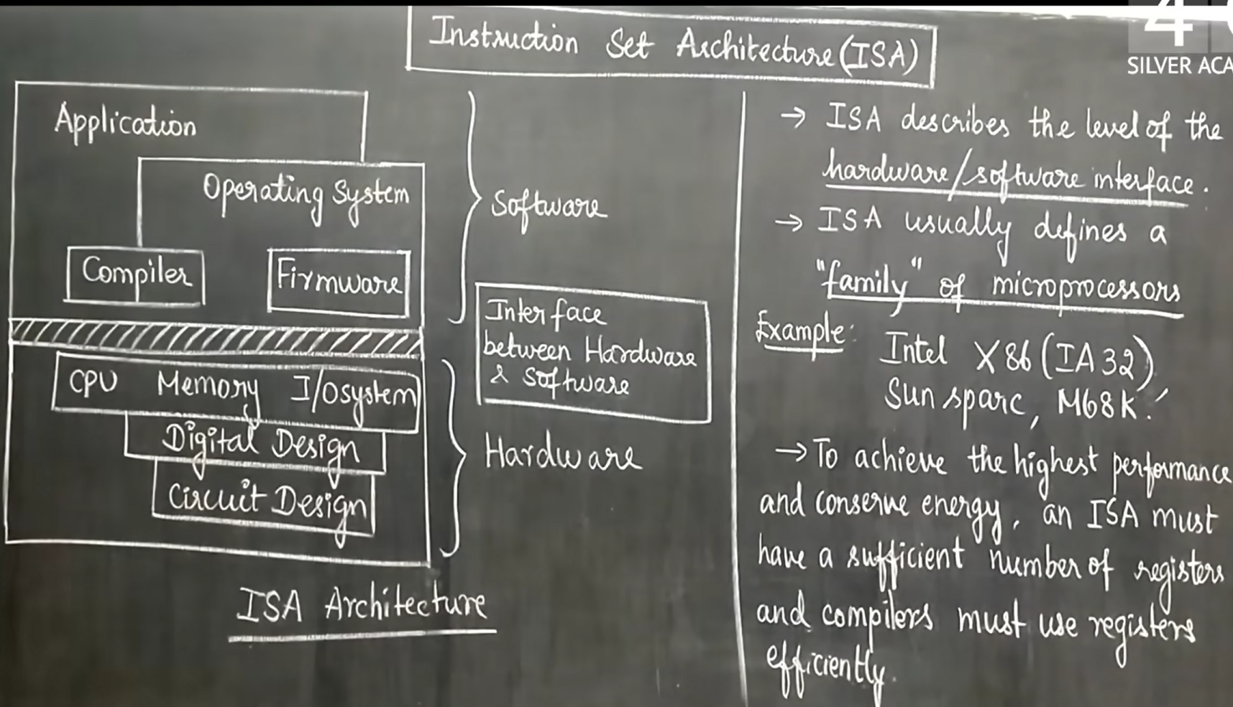

Slide 70
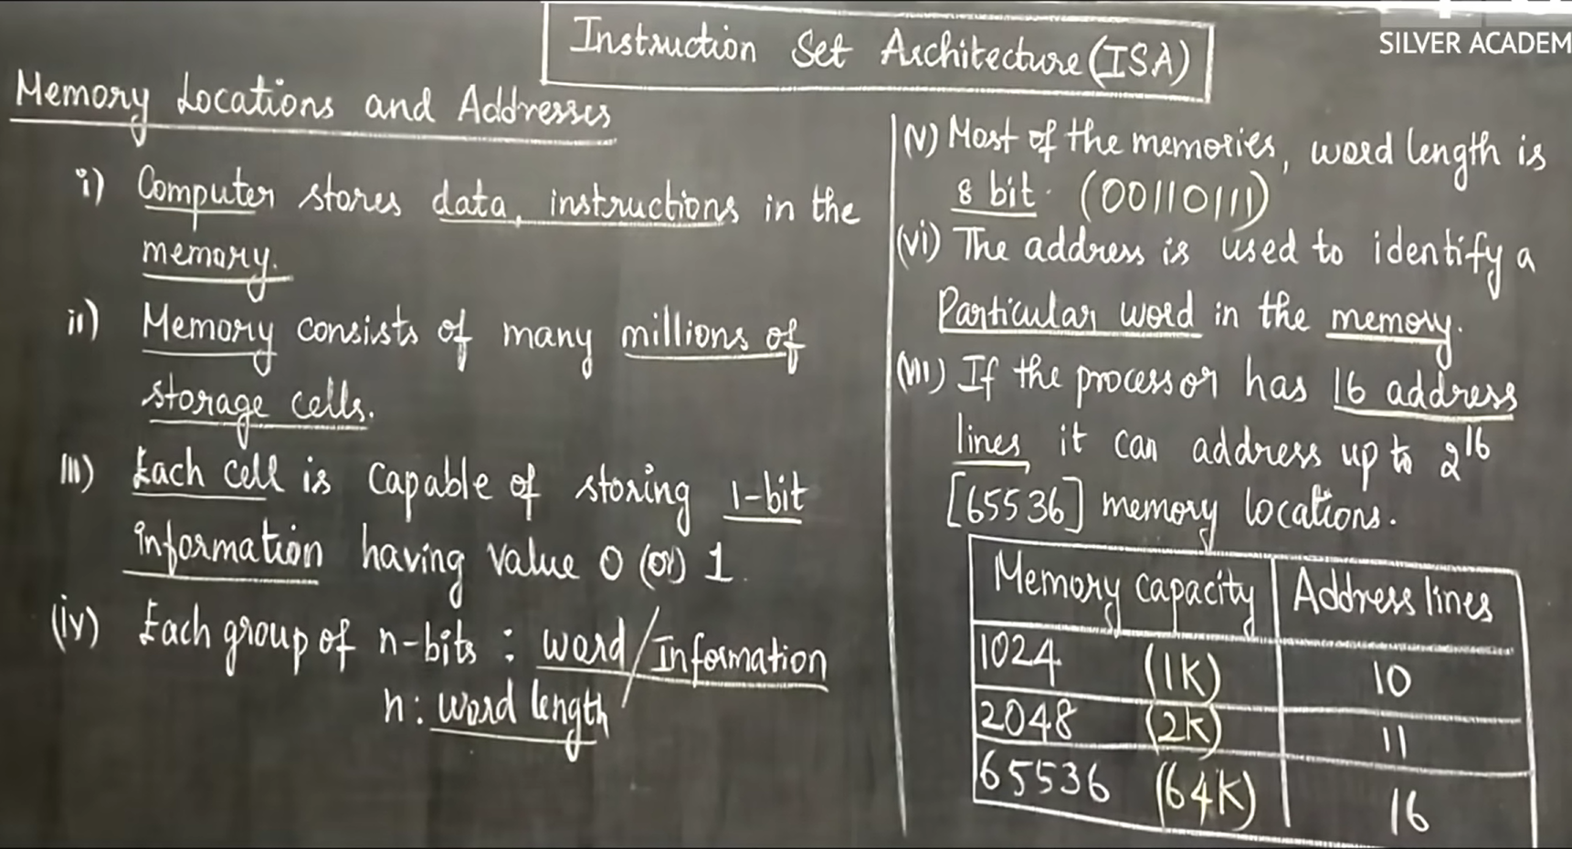

Slide 71
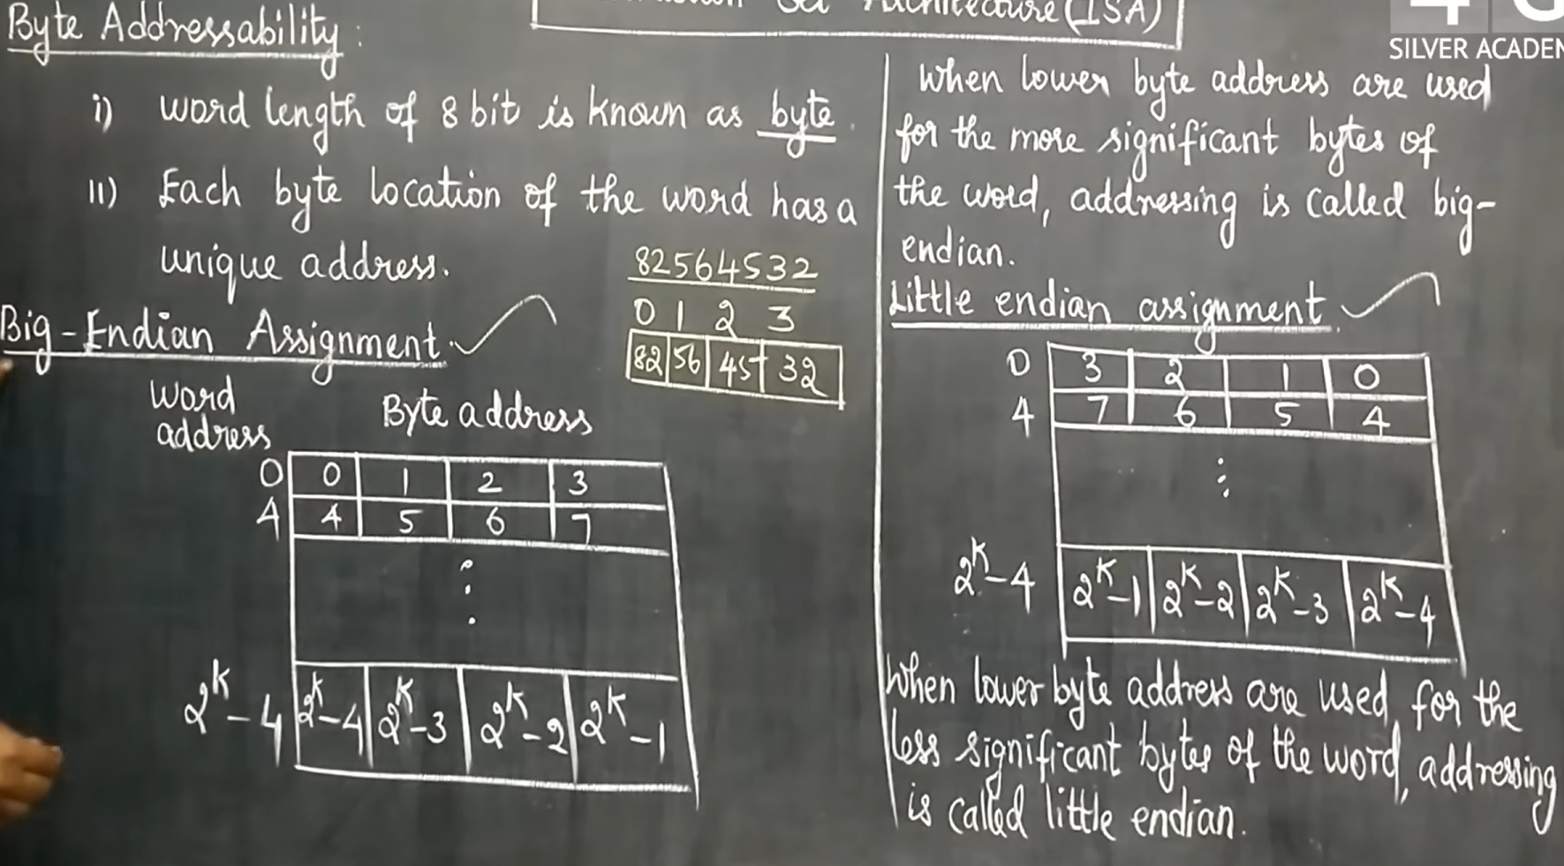

Slide 72
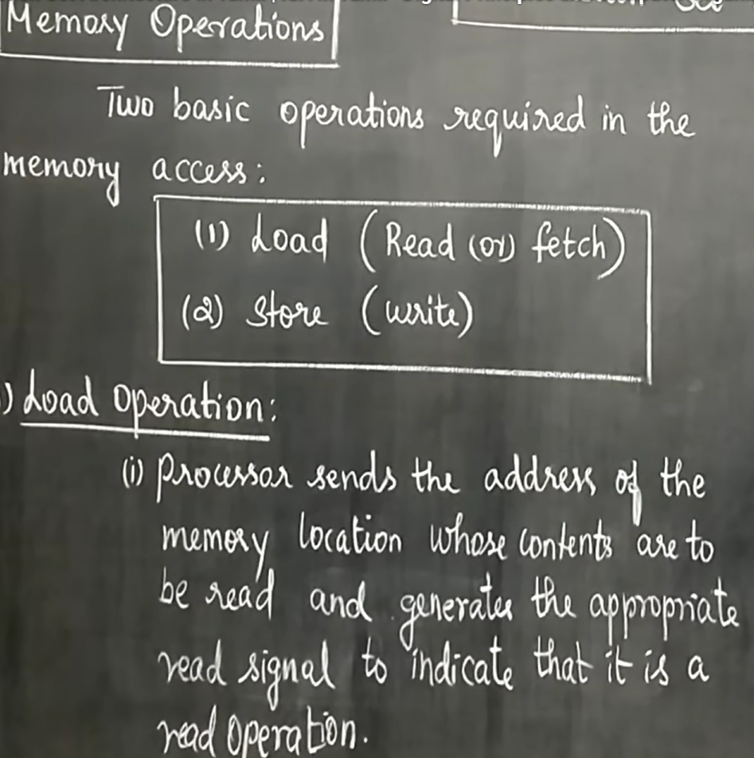
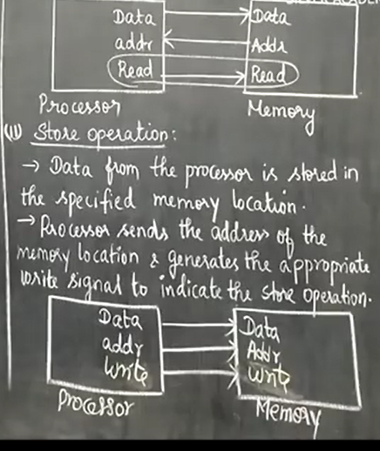

Slide 73
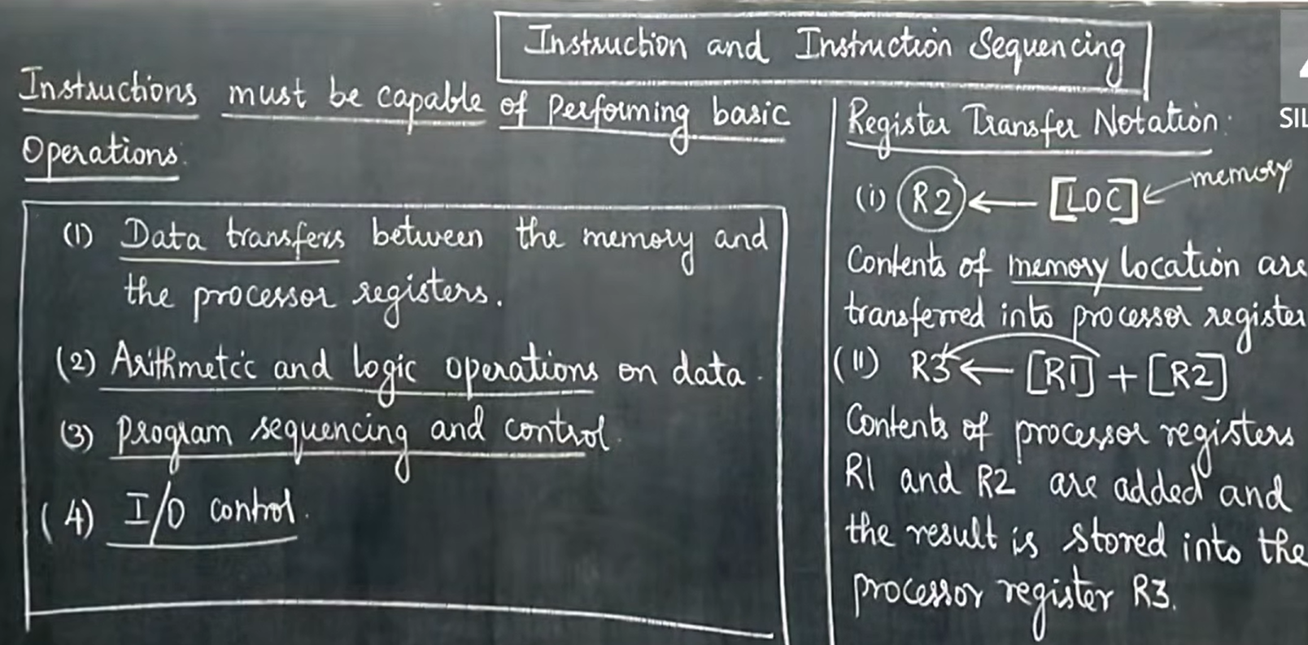

Slide 74

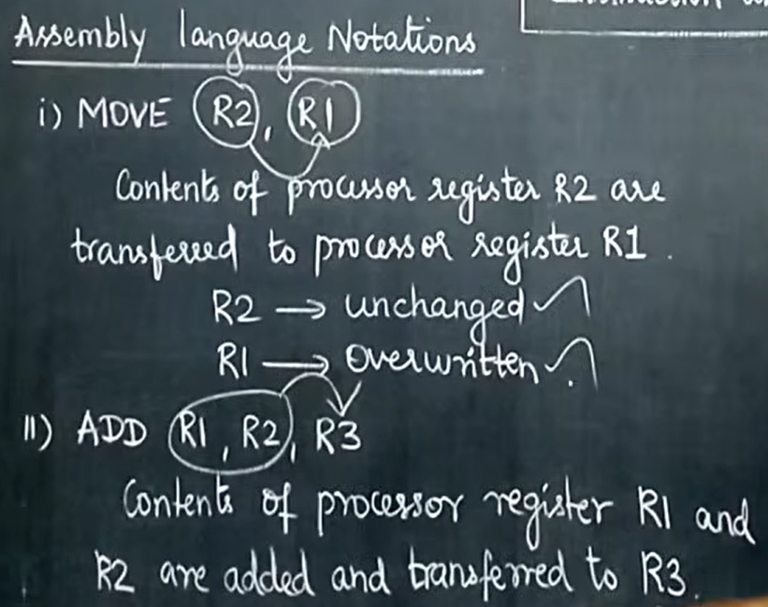
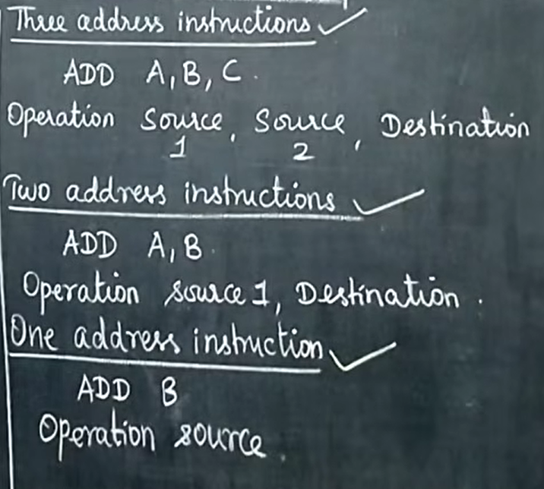

Slide 75
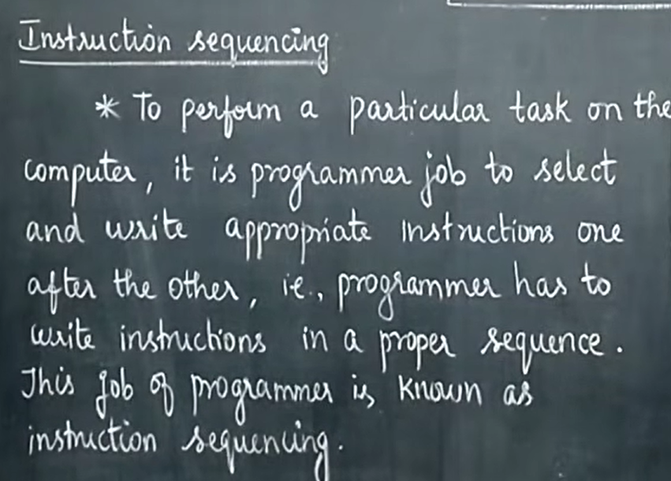

Slide 76
